Slide 1

离散数学
Discrete Mathematics
钟芳明
离散数学
Discrete Mathematics

Slide 2
Review
Translation of predicate formula
Rules of Inference
Bound variable rename
Free variable substitution
Propositional substitution rule
Replacement rule
Addition and deletion rules for quantifiers
US（Universal Specialization）
ES（Existential specialization）
EG（existential generalization）
UG（universal generalization）
Extension of propositional reasoning rules of predicate logic
P rule
T rule
CP rule
F rule

Slide 3
Predicate logic to solve real problems
Steps：
Define a set of predicates based on the needs of the problem
Symbolize actual problems
Effective reasoning using inference rules
Note：
Symbolic principle ：The universal quantifier corresponds to the logical connection → , and the existential quantifier corresponds to the logical connection Λ
We introduce the premise with existential quantifier to ensure validity of the "ES" rule

Slide 4
Methods of Inference
假定推导过程都是在相同的个体域内进行的（通常是全总个体域）。
综合推理方法
推导过程中可以引用命题演算中的规则 P 和规则 T；
如果结论是以条件形式或析取形式给出，则可使用规则 CP；
若需消去量词，可以引用规则 US 和规则 ES；
当所求结论需定量时，可引用规则 UG 和规则 EG引入量词;
证明时可采用如命题演算中的直接证明方法和间接证明方法;
推导过程中，对消去量词的公式或公式中不含量词的子公式，可以引用命题 演算中的基本等价公式和基本蕴涵公式;
推导过程中，对含有量词的公式可以引用谓词中的基本等价公式和基本蕴涵公式。

Slide 5
Nodus of Inference
推理难点总结
在推导过程中，如既要使用规则 US 又要使用规则 ES 消去量词，而且选用的个体是同一个符号，则必须先使用规则 ES，再使用规则 US。然后再使用命题演算中的推理规则，最后使用规则 UG 或规则 EG 引入量词，得到所求结论。
如一个变量是用规则 ES 消去量词，对该变量在添加量词时，则只能使用规则 EG；如使用规则 US 消去量词，对该变量在添加量词时，则可使用规则 EG 和规则 UG。
在用规则 US 和规则 ES 消去量词时，此量词必须位于整个公式的最前端，且辖域为其后的整个公式。
在添加量词 (∀x) 和 (∃x) 时，所选用的 x 不能在公式 G(y) 或 G(c) 中出现。

Slide 6
CP-rule
Prove：(∀x)(P(x) ∨ Q(x)) ⇒ (∀x)P(x) ∨ (∃x)Q(x)
Solution：
Proof：
(1) ¬(∀x)P(x) P(附加前提)
(2) (∃x)¬P(x) T, (1),
(3) ¬P(c) ES, (2)
(4) (∀x)(P(x) ∨ Q(x)) P
(5) P(c) ∨ Q(c) US, (4)
(6) Q(c) T, (3), (5)
(7) (∃x)Q(x) EG, (6)
(8) ¬(∀x)P(x) → (∃x)Q(x) CP, (1), (7)
(9) (∀x)P(x) ∨ (∃x)Q(x) T, (8), E
Notes:
命题逻辑中使用过CP规则和反证法
谓词逻辑同样适用
（3）、（5）选言三段论

Slide 7
Proofs by Contradiction, F-rule
Prove：(∀x)(P(x) ∨ Q(x)) ⇒ (∀x)P(x) ∨ (∃x)Q(x)
Proof：
(1) ¬((∀x)P(x) ∨ (∃x)Q(x)) P(假设前提)
(2) ¬(∀x)P(x) ∧ ¬(∃x)Q(x) T, (1)
(3) ¬(∀x)P(x) T, (2)
(4) ¬(∃x)Q(x) T, (2)
(5) (∃x)¬P(x) T, (3), E
(6) ¬P(c) ES, (5)
(7) (∀x)¬Q(x) T, (4), E
(8) ¬Q(c) US, (7)
(9) ¬P(c) ∧ ¬Q(c) T, (6), (8)
(10) ¬(P(c) ∨ Q(c)) T, (9), E
(11) (∀x)(P(x) ∨ Q(x)) P
(12) P(c) ∨ Q(c) US, (11)
(13) (P(c) ∨ Q(c)) ∧ (¬(P(c) ∨ Q(c))) T, (10), (12)

Slide 8
Examples
Show that the premises “A student in discrete mathematics class has not read the book,” and “Everyone in discrete mathematics class passed the first exam” imply the conclusion “Someone who passed the first exam has not read the book.”
Solution
D(x) ： x is student in discrete mathematics class, B(x)：x has read the book, P(x)：x passed the exam，then the statements can be expressed as：
(∃x)(D(x) ∧¬B(x))，
(∀x)(D(x) → P(x))
(∃x)(P(x) ∧¬B(x))
Next page…

Slide 9
Examples
Solution
(∃x)(D(x) ∧¬B(x))，(∀x)(D(x) → P(x)) ⇒ (∃x)(P(x) ∧¬B(x))
Proof：
(1) (∃x)(D(x) ∧¬B(x)) P
(2) D(c) ∧¬B(c) ES, (1)
(3) D(c) T, (2)
(4) ¬B(c) T, (2)
(5) (∀x)(D(x) → P(x)) P
(6) D(c) → P(c) US, (5)
(7) P(c) T, (3), (6)
(8) P(c) ∧¬B(c) T, (4), (7)
(9) (∃x)(P(x) ∧¬B(x)) EG, (8)

Slide 10
Chapter 2 Predicate logic
2.5 Normal form of predicate formula

Slide 11
Normal form of predicate formula
前束范式
斯柯林范式
The two normal forms in propositional logic can be directly extended to the predicate logic, as long as the atomic proposition formula is replaced by the atomic predicate formula.
According to the different situations in which the quantifiers appear in the formula, they can be divided into the Prenex normal form (前束范式) and the Skolem Paradigm（斯柯林范式）.

Slide 12
Prenex Normal Form
前束范式
斯柯林范式
Definition: For any predicate formula F, if all of the quantifiers are non-negative in the front of the formula, and their scope is the entire formula, then the formula F is called the prenex normal form.

Slide 13
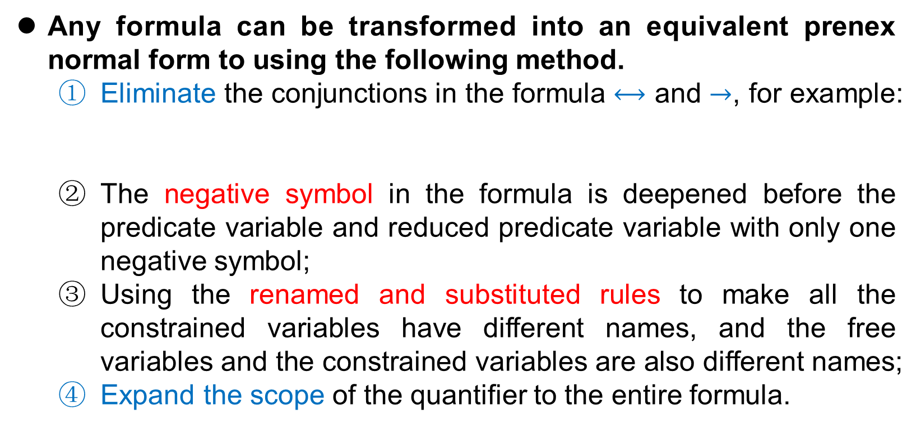
Prenex Normal Form
前束范式
斯柯林范式
Any formula can be transformed into an equivalent prenex normal form to using the following method.
Eliminate the conjunctions in the formula $⟷$ and $→$, for example:
The negative symbol in the formula is deepened before the predicate variable and reduced predicate variable with only one negative symbol;
Using the renamed and substituted rules to make all the constrained variables have different names, and the free variables and the constrained variables are also different names;
Expand the scope of the quantifier to the entire formula.

Slide 14
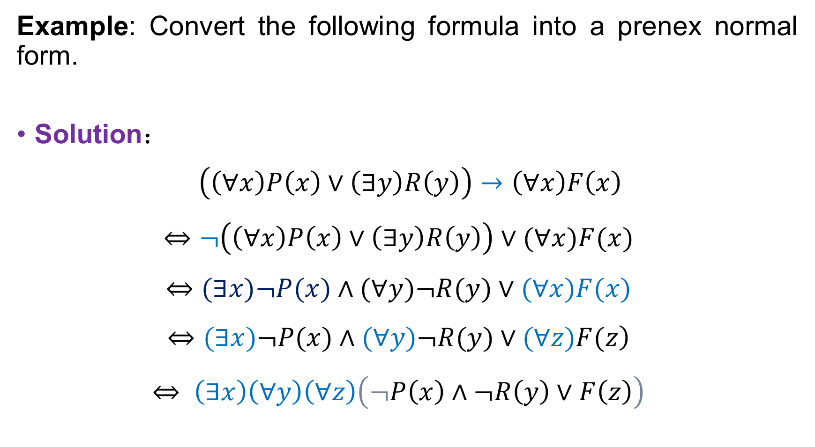
Prenex Normal Form
前束范式
斯柯林范式
Example: Convert the following formula into a prenex normal form.
Solution：
$$\left(\left(∀x\right)P\left(x\right)∨\left(∃y\right)R\left(y\right)\right)→\left(∀x\right)F\left(x\right)$$
$$⇔¬\left(\left(∀x\right)P\left(x\right)∨\left(∃y\right)R\left(y\right)\right)∨(∀x)F(x)$$
$$⇔(∃x)¬P(x)∧(∀y)¬R(y)∨(∀x)F(x)$$
$$\left.⇔(∃x)¬P(x)∧(∀y)¬R(y)∨(∀z)F(z\right)$$
$$⇔ \left(∃x\right)\left(∀y\right)\left(∀z\right)\left(¬P\left(x\right)∧¬R\left(y\right)∨F\left(z\right)\right)$$

Slide 15
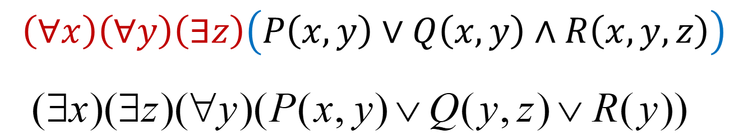
Skolem Paradigm
前束范式
斯柯林范式
Definition: If all of the existential quantifiers in the prenex normal form are before the universal quantifier, then this form is called the Skolem Paradigm.

Slide 16
Skolem Paradigm
前束范式
斯柯林范式
Any formula can be turned into the equivalent Skolem paradigm as follows:
First formulate the given formula into the prenex normal form;
Constraining all free variables in the prenex normal form with the full quantifier (UG);
If, in the above modified formula A, the first quantifier is not a existential quantifier, the equivalence can be transformed into the following form：
If the prenex normal form begins with n existential quantifiers, then m full quantifiers, followed by existential quantifiers, we can use the following equivalence to move these full quantifiers one by one after the existential quantifiers:

Slide 17
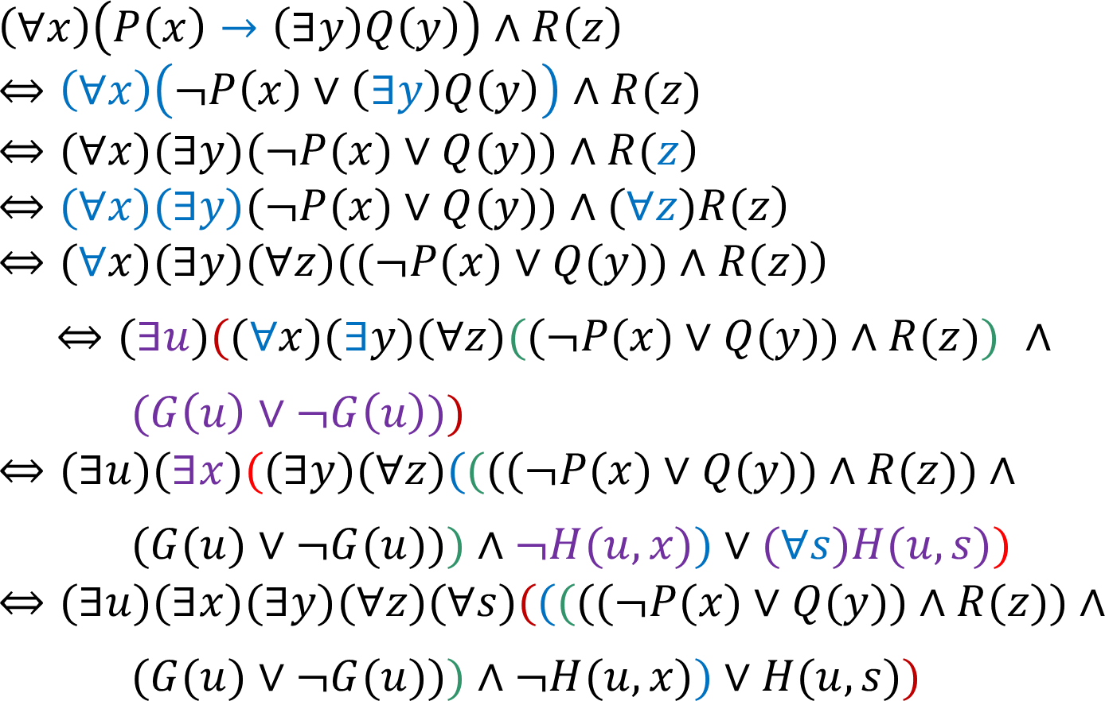
Skolem Paradigm
前束范式
斯柯林范式
Example: Write the Skolem Normal Form of formula

Slide 18

The End
Thanks

